Slide 1

How agriculture sector more contributes in economy of India?
November 2022
Ankit Kumar
Junior Member
IIT Ropar
Economy

Slide 2
Executive Summary
Farmer are the ones who provide us food to eat. Since every person needs proper food for their living, so they are a necessity in society .But we now days, no one ready to become farmer due it has no future grow and no stability ,more envolment but less benefit ,so we need to resolve the issue make more efficient in different
Agricultural land (% of land area) in India was reported at 60.22 % in 2020, according to the World Bank collection .
Agriculture provides employment opportunities to rural agricultural and non-agricultural laborer's. It plays a significant role in international trade and import and export activities
Government has taken several steps for increasing investment in agriculture sector such as enhanced institutional credit to farmers; promotion of scientific warehousing infrastructure for increasing shelf life of agricultural produce; setting up of Agri-tech Infrastructure Fund for making farming competitive and profitable; developing commercial organic farming etc.
38% digital literacy rate are increase last year in rural areas , directly help to handle different technology like pesticides, kisan suvidha,agri app,etc.
https://www.toppr.com/guides/essays/farmer-essay/#:~:text=Importance%20of%20farmers,-Farmers%20have%20great&text=They%20are%20the%20ones%20who%20provide%20us%20food%20to%20eat,they%20all%20have%20equal%20significance.

Slide 3
Does India have enough land to produce crops ?
Land distribution in India
Share of operated area
Average size of land holding
4.3%
21.20%
67.1%
10.60%
https://thewire.in/agriculture/land-reforms-fail-5-of-indias-farmers-control-32-land

Slide 4
Land Reforms Fail; 5% of India’s Farmers Control 32% Land
As many as 570 million Indians, or 47.1% (including 6.7% in urban areas), still depend on agriculture, which contributes 15% to Gross Domestic Product (GDP), according to this 2011-12 National Sample Survey Office 2011-12 2011-12 report and 2011 census data.
The average size of holdings for all operational classes (small & marginal, medium and large) have declined over the years and for all classes put together it has come down to 1.16 hectare in 2010-11 from 2.82 hectare in 1970-71.”
The average land given to the rural landless is small and falling, from 0.95 acres in 2002 to 0.88 acres in 2015—a 7.4% drop over13 years–and a slowdown is evident in the process of taking land away from rich landlords
Idea which help in increasing land for agriculture
Stopping land-holding exemptions to religious, educational, charitable, research and industrial organizations beyond 15 acres;
Allowing smaller land-holdings in states where the existing limit is more than five to 10 acres for irrigated land and 10 to 15 acres for non-irrigated land;
A “single-window” to redistribute surplus land within a specified time;
A crackdown on benami—in someone else’s name—land;
A database of land inventories available for public scrutiny
https://thewire.in/agriculture/land-reforms-fail-5-of-indias-farmers-control-32-land

Slide 5
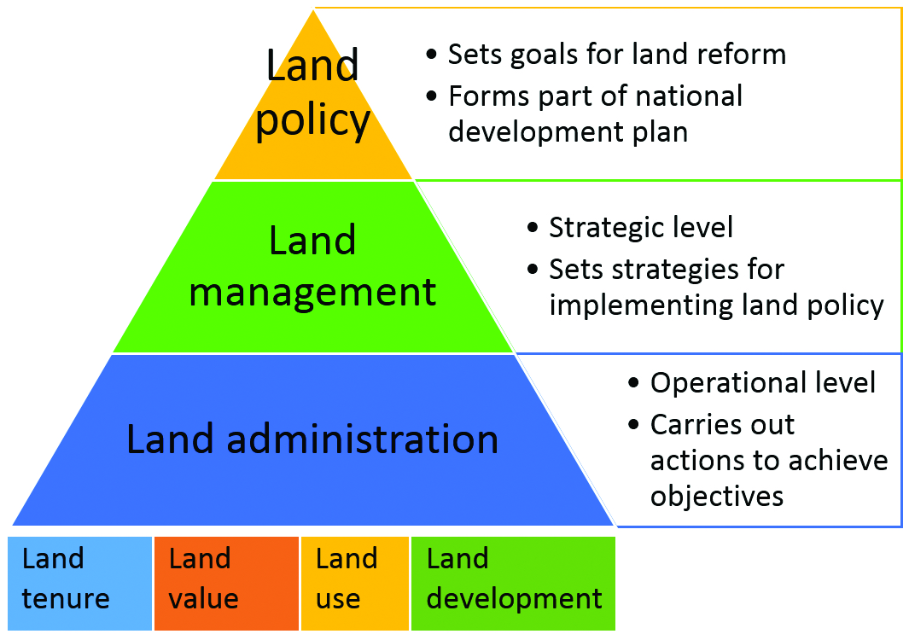
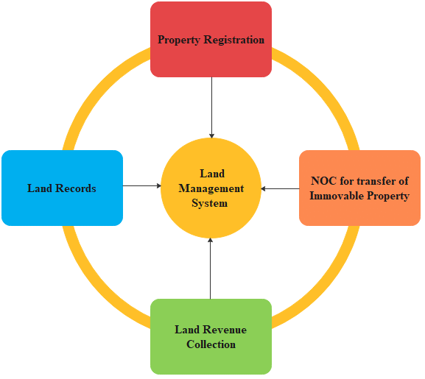
https://samajho.com/upsc/land-reforms-in-india/

Slide 6
Does India have technology to support farmer?
Different issues with using technology for farmer
LITERACY RATE
As of 2021, the literacy rate in rural India was around 73.5%. This includes 81% male and 65% female literacy in rural section of India. As the rural economy currently contributes to 25-30% of the country's GDP, literacy in these parts is important for the Indian economy.
sources
Electricity consumption in the agriculture sector has constantly increased in the last two decades. From 84,729 Gigawatt hours in 2000-01, it rose to 1.08 lakh GWh in 2009-10 and reached 2.28 lakh GWh in 2019-20.
Promote to harvest rainwater ,solar motor ,use hybrid seeds
Land Holding
The average size of holdings for all operational classes (small & marginal, medium and large) have declined over the years and for all classes put together it has come down to 1.16 hectare in 2010-11 from 2.82 hectare in 1970-71.”
https://www.ibef.org/blogs/rural-education-integral-to-india-sprogress#:~:text=As%20of%202021%2C%20the%20literacy,important%20for%20the%20Indian%20economy.
9

Slide 7
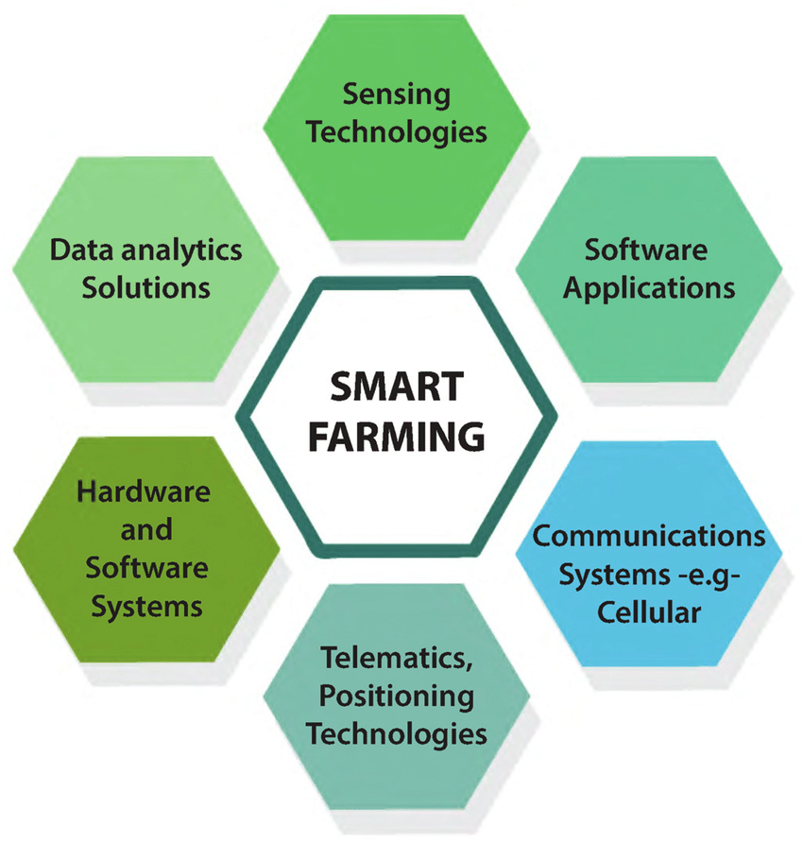
Jharkhand is 1st state to implement blockchain in the country which is being used to track seed distribution and Crop irrigation systems are being monitored and controlled with the use of mobile.
AI(14%), precision agriculture(11%),agribiotech(6%),robotics(12%),drones(13%)
https://www.ideasforindia.in/topics/governance/the-digital-dream-upskilling-india-for-the-future.html

Slide 8

Growing various crops and co-operative sector can enhance economy of India
CROPS
Major crops grown in India are rice, wheat, millets, pulses, tea, coffee, sugarcane, oil seeds, cotton and jute, etc. of canal irrigation and tube wells have made it possible to grow rice in areas of less rainfall such as Punjab, Haryana and western Uttar Pradesh and parts of Rajasthan
Co-operative
. The country has 1,94,195 cooperative dairy societies and 330 cooperative sugar mill operations. Cooperative sugar mills account for 35% of the sugar produced in the country. In banking and finance, cooperative institutions are spread across rural and urban areas.
https://www.researchgate.net/publication/238067964/figure/fig2/AS:669480401252373@1536627974972/Spread-of-cooperative-activity-by-sector-by-number-of-cooperatives.png

Slide 9
Support of government boost the efficiency of agriculture
In the first quarter of FY 2020-21, when the Indian economy registered 23.9 percent negative growth, agriculture was the only sector which emerged as a silver lining for India’s economy makes agriculture the most prominent sector in country. And therefore, it needs a lot of public sector support for a sustainable growthier recovery with over 3.4 percent growth.
PMKSNY
PMKMY
KCC
NMSD
PMKSY
e-NAM
https://vikaspedia.in/schemesall/schemes-for-farmers

Slide 10
Solution Framework
Land reform
Technology
Government schemes
Future prospective
Digital education
(benefit of farmer in future)

